Slide 1
Electrical Machines
By Dr. M. Chinna Obaiah,
Assistant Professor (Sr), SELECT, VIT Vellore.

Slide 2
Special Machines
Stepper Motor
Servo Motor
Brushless DC Motor

Slide 3
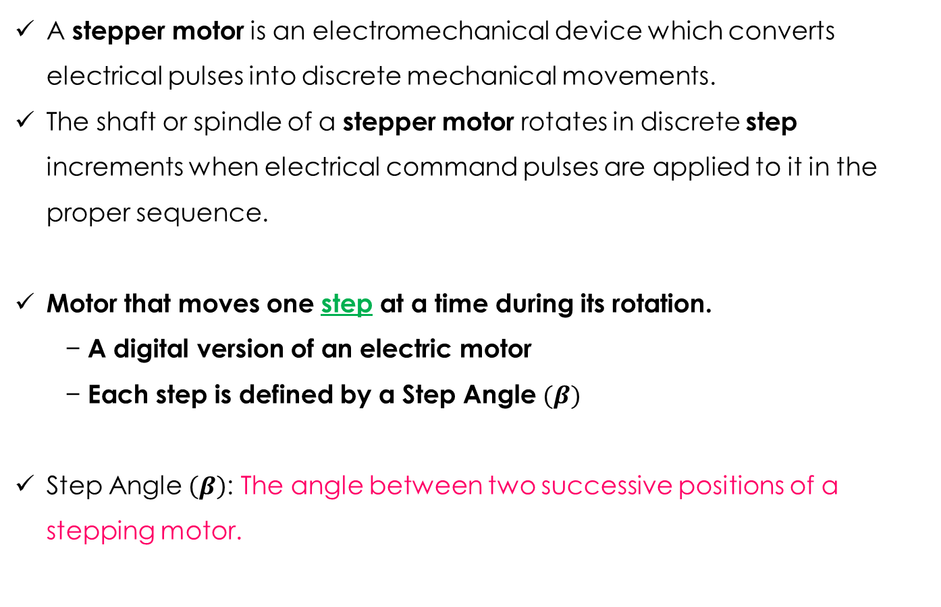
Stepper Motor
A stepper motor is an electromechanical device which converts electrical pulses into discrete mechanical movements.
The shaft or spindle of a stepper motor rotates in discrete step increments when electrical command pulses are applied to it in the proper sequence.
Motor that moves one step at a time during its rotation.
− A digital version of an electric motor
− Each step is defined by a Step Angle $(β)$
Step Angle $\left(β\right)$: The angle between two successive positions of a stepping motor.

Slide 4
Why a Stepper Motor?
Relatively inexpensive
Ideal for open loop positioning control
Can be implemented without feedback
Minimizes sensing devices
Just count the steps!
Torque
Holds its position firmly when not turning
Eliminates mechanical brakes
Produces better torque than DC motors at lower speeds
Positioning applications

Slide 5
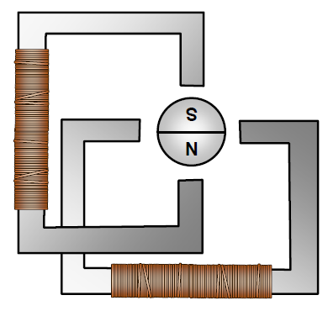
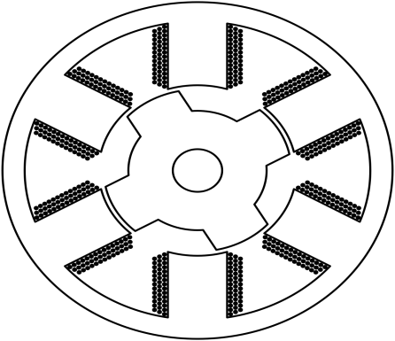
Main Components
Stator
Consists of
Stator
− Holds multiple windings/phases
Rotor
− Magnetized
or
− Non-magnetized
Rotor
Magnetized
rotor
multiple
windings/phases
Non-Magnetized
rotor (iron)
Notes:
Magnetized rotor

Slide 6
Step Angle - β
The angle between two successive positions of a stepping motor.
As small as 0.78º to 90º
Most commonly used – 1.8º, 2.5º, 7.5º, 15º
β = (N_{s}-N_{r}) x 360º = 360º
N_{s}.N_{r} mN_{r}
N_{s} – No. of Stator poles (teeth)
N_{r} – No. of Rotor poles (teeth)
m - No. of stator phases
Resolution
Resolution = No. of steps/revolution
= 360º/β

Slide 7
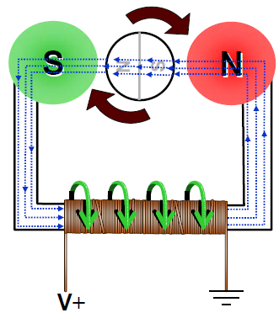
Working Principle of Stepper Motor
The stepper motor rotor is a permanent magnet, when the current flows through the stator winding, the stator winding to produce a vector magnetic field.
The magnetic field drives the rotor to rotate by an angle so that the pair of magnetic fields of the rotor and the magnetic field direction of the stator are consistent.
When the stator's vector magnetic field is rotated by an angle, the rotor also rotates with the magnetic field at an angle.
Each time an electrical pulse is input, the motor rotates one degree further.
The angular displacement it outputs is proportional to the number of pulses input and the speed is proportional to the pulse frequency.
Change the order of winding power, the motor will reverse.
Therefore, it can control the rotation of the stepping motor by controlling the number of pulses, the frequency and the electrical sequence of each phase winding of the motor.

Slide 9
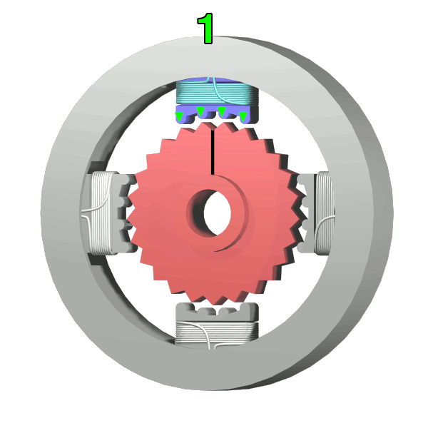
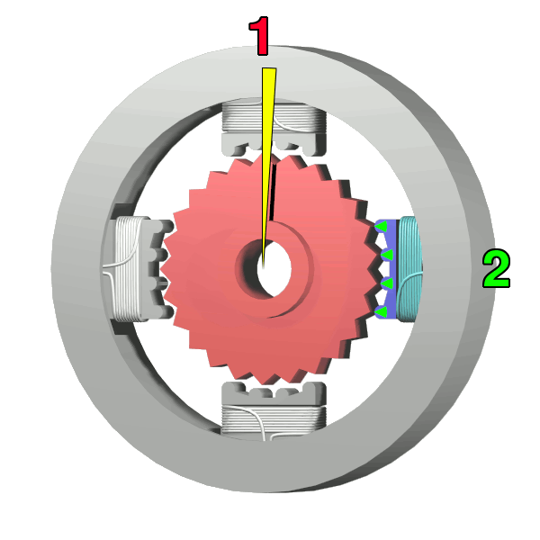
Stepper motor operation
The top electromagnet (1) is turned on, attracting the nearest teeth of a gear-shaped iron rotor. With the teeth aligned to electromagnet 1, they will be slightly offset from electromagnet 2
The top electromagnet (1) is turned off, and the right electromagnet (2) is energized, pulling the nearest teeth slightly to the right. This results in a rotation of 3.6° in this example.

Slide 10
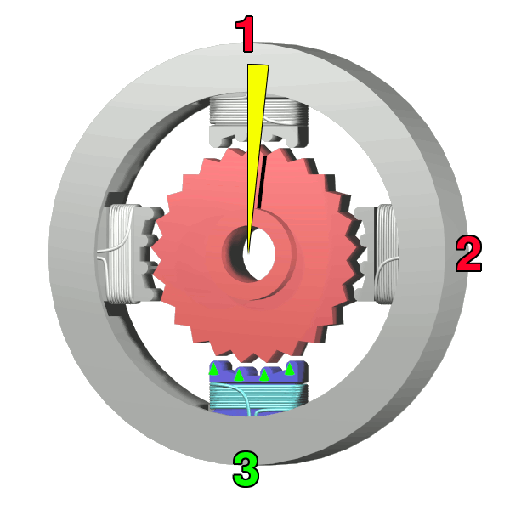
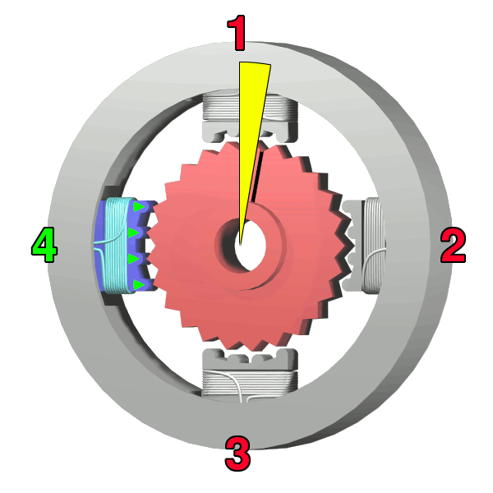
Stepper motor operation (contd.,)
The bottom electromagnet (3) is energized; another 3.6° rotation occurs.
The left electromagnet (4) is enabled, rotating again by 3.6°. When the top electromagnet (1) is again enabled, the teeth in the sprocket will have rotated by one tooth position; since there are 25 teeth, it will take 100 steps to make a full rotation in this example.

Slide 11
Types of Stepper Motors
Variable Reluctance stepper motor
Non-magnetic, geared rotor
Permanent Magnet Stepper motor
Magnetic rotor
Hybrid stepper motor
Combines characteristics from PM and VR
Magnetic, geared rotor

Slide 12
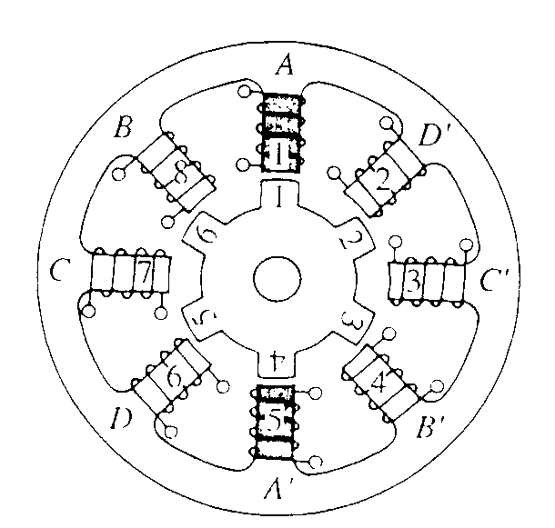
Variable-Reluctance (VR) Stepper Motor
Toothed Rotor and Toothed Stator
Principle of Operation:
Reluctance of the magnetic circuit formed by the rotor and stator teeth varies with the angular position of the rotor
Here, energize coils A and A’ (Phase A)
Rotor “steps” to align rotor teeth 1 and 4 with stator teeth 1 and 5

Slide 13
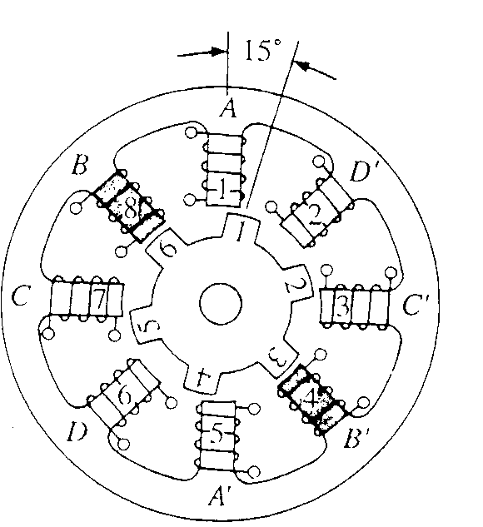
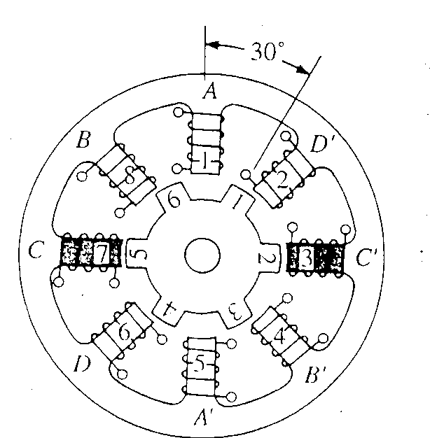
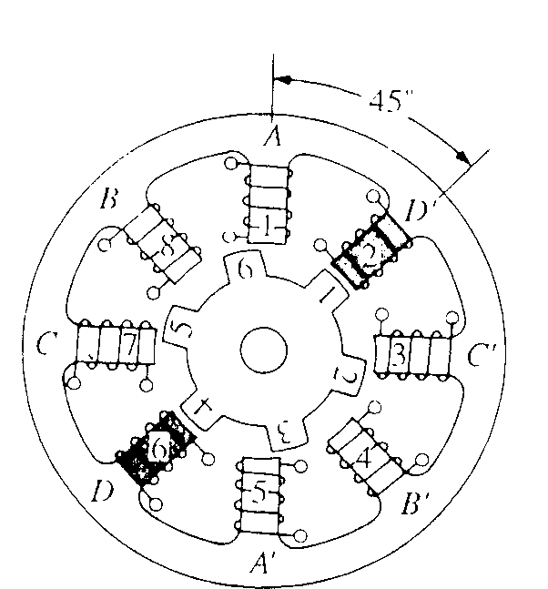
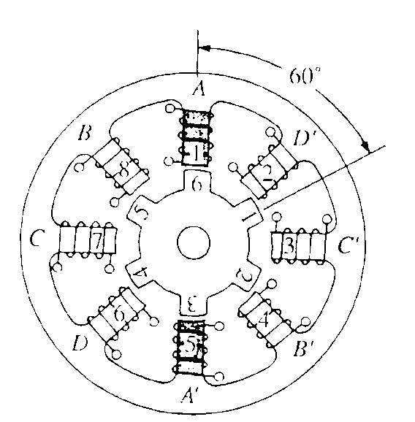
Energize Phase C
Rotor steps forward another 15°
Energize coils B and B’ (Phase B)
Rotor steps “forward”
Rotor teeth 3 and 6 align with Stator teeth 1 and 5
Energize Phase D
Rotor steps forward another 15°
Repeat the sequence
Energize Phase A
Rotor steps forward again

Slide 14
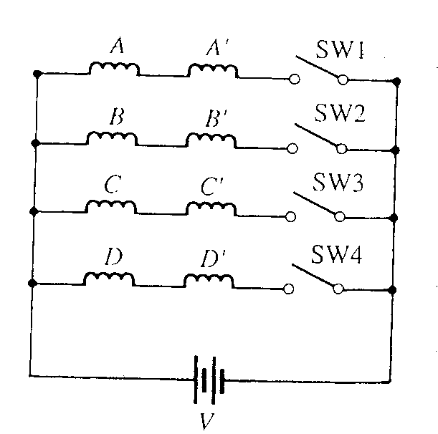
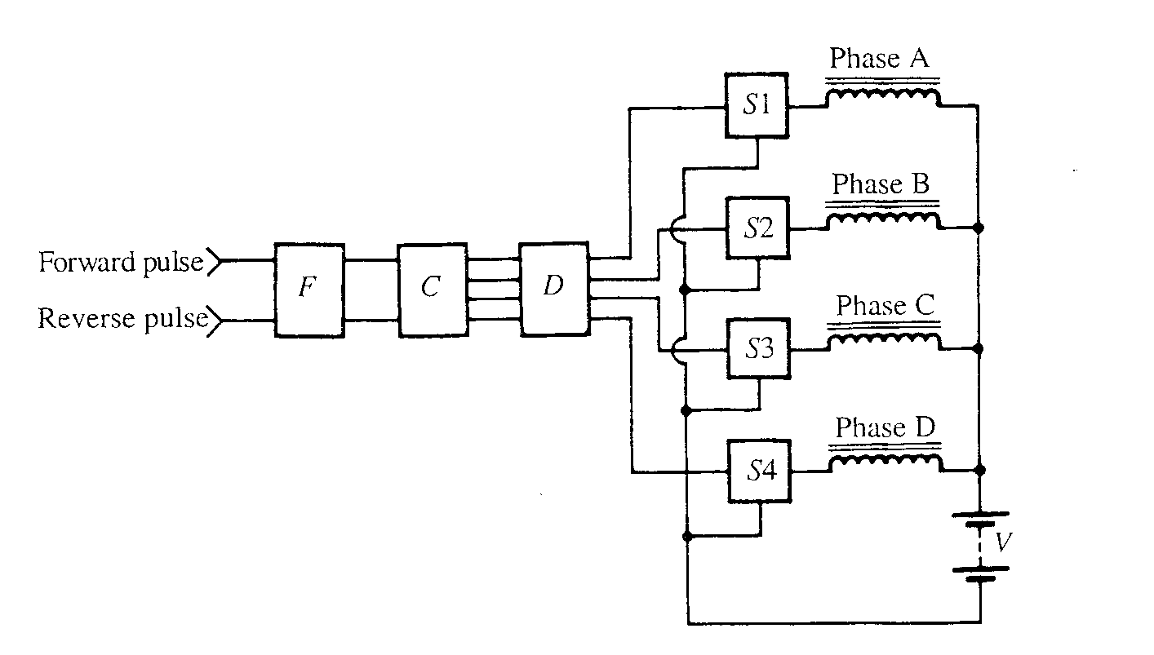
Switching Circuit for the stepper motor
Close switches in order 1, 2, 3, and 4 to turn the rotor “clockwise”
Close switches in reverse order - 4, 3, 2, and 1 to change rotation to the opposite (counter-clockwise) direction
Variable-Reluctance Stepper Motor Typical Driver Circuit
F = “filter” block
C = Up/Down Counter
D = Decoder
S = Electronic Switch (transistor)

Slide 15
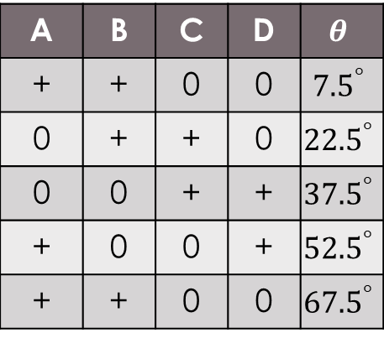
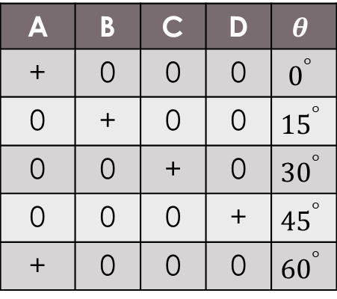
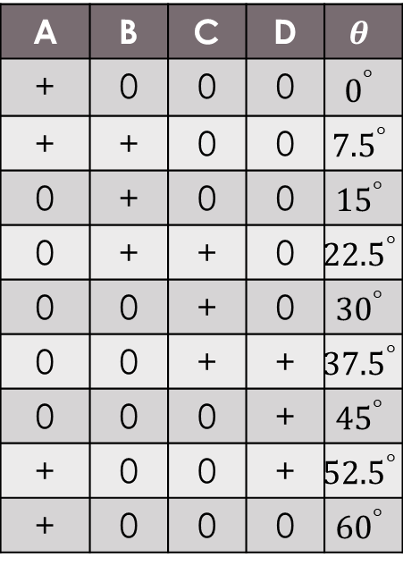
Modes of operation –VR type
1-phase ON – full step operation
2-phase ON
Half-step – alternate 1-phase & 2-phase mode
Micro stepping
A | B | C | D | $$θ$$
+ | 0 | 0 | 0 | $$0^{°}$$
0 | + | 0 | 0 | $${15}^{°}$$
0 | 0 | + | 0 | $${30}^{°}$$
0 | 0 | 0 | + | $${45}^{°}$$
+ | 0 | 0 | 0 | $${60}^{°}$$
A | B | C | D | $$θ$$
+ | + | 0 | 0 | $${7.5}^{°}$$
0 | + | + | 0 | $${22.5}^{°}$$
0 | 0 | + | + | $${37.5}^{°}$$
+ | 0 | 0 | + | $${52.5}^{°}$$
+ | + | 0 | 0 | $${67.5}^{°}$$
A | B | C | D | $$θ$$
+ | 0 | 0 | 0 | $$0^{°}$$
+ | + | 0 | 0 | $${7.5}^{°}$$
0 | + | 0 | 0 | $${15}^{°}$$
0 | + | + | 0 | $${22.5}^{°}$$
0 | 0 | + | 0 | $${30}^{°}$$
0 | 0 | + | + | $${37.5}^{°}$$
0 | 0 | 0 | + | $${45}^{°}$$
+ | 0 | 0 | + | $${52.5}^{°}$$
+ | 0 | 0 | 0 | $${60}^{°}$$
1-phase ON
Mode- ABCDA
2-phase ON
Mode- AB, BC, CD, DA, AB
Half-step
Mode- A, AB, B, BC, C ,CD, D, DA, A

Slide 16
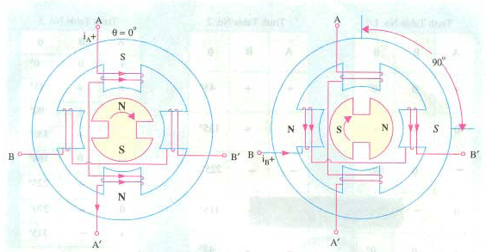
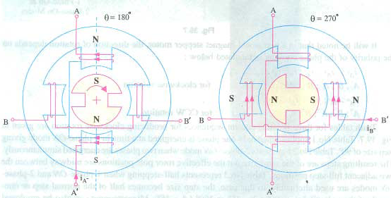
Permanent Magnet (PM) Stepper motor
Rotor poles – permanent magnet
Greater resolution as pole pairs increase or Additional Phases

Slide 17
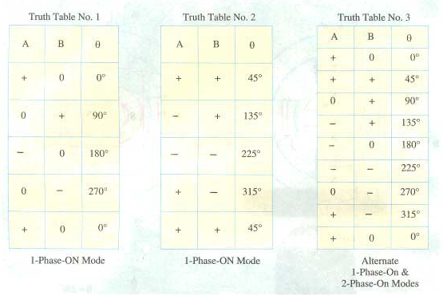
Modes of Operation – PM type
1-phase ON mode
2-phase ON mode
Half step mode

Slide 18
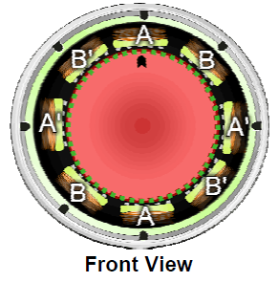
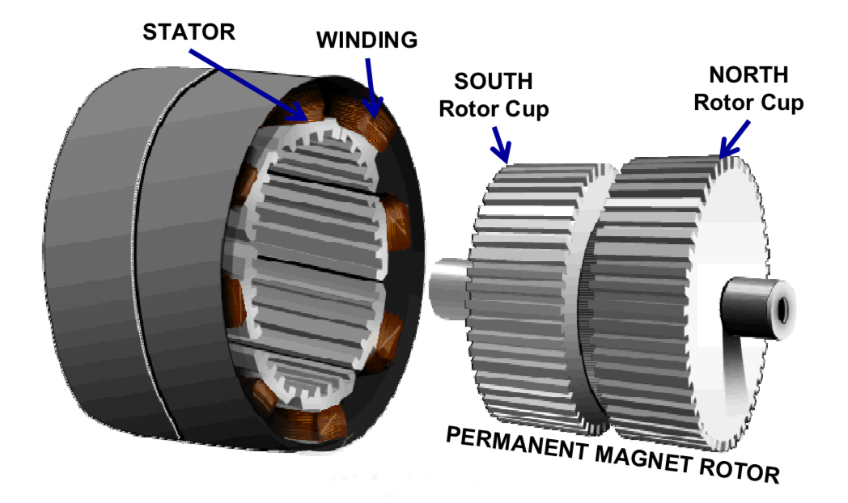
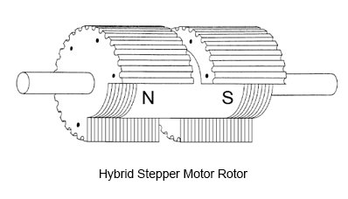
Hybrid stepper motor
Combination of VR and PM
Wound Stator poles – (similar to VR)
Rotor poles – permanent magnet
Rotor shape – not Cylindrical
Direction – stator current polarity

Slide 19
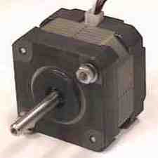
Advantages / Disadvantages
Advantages:-
Low cost for control achieved
Ruggedness
Simplicity of construction
Can operate in an open loop control system
Low maintenance
Less likely to stall or slip
Will work in any environment
Disadvantages:-
Require a dedicated control circuit
Use more current than D.C. motors
High torque output achieved at low speeds

Slide 20
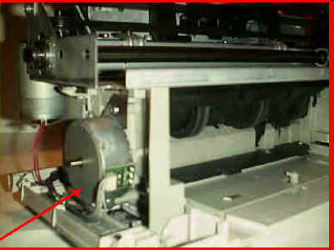
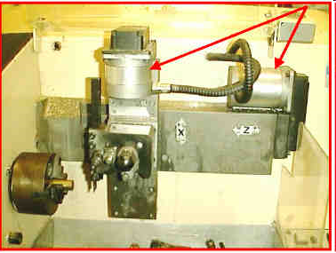
Stepper motor applications
Paper feeder on printers
Stepper motors
CNC lathes

Slide 21
Stepper motor applications (contd.,)
Computer peripherals
Textile industries
IC fabrications
Robotics
Applications requiring incremental motion
Typewriters
Line printers
Tape drives
Floppy disk drives
Numerically-controlled machine tools
Process control systems
X-Y plotters

Slide 22
Servo Motors

Slide 23
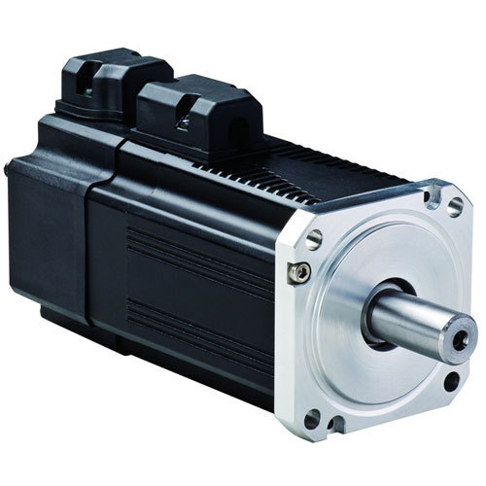
Servo Motors
A servo motor is one of the widely used variable speed drive in industrial production and process automation and building technology world wide.
These not specified to any class of motors.
These are intended and designed to used in motion control applications which requires high accuracy positioning, quick reversing, and exceptional performances.
It is a linear or rotary actuator that provides fast precision position control for closed-loop position control applications.
It is not used for continuous energy conversion
Applications:
Robotics, Radar Systems
Automated manufacturing systems,
Machine tools, Computers,
CNC Machines,
Tracking Systems

Slide 24
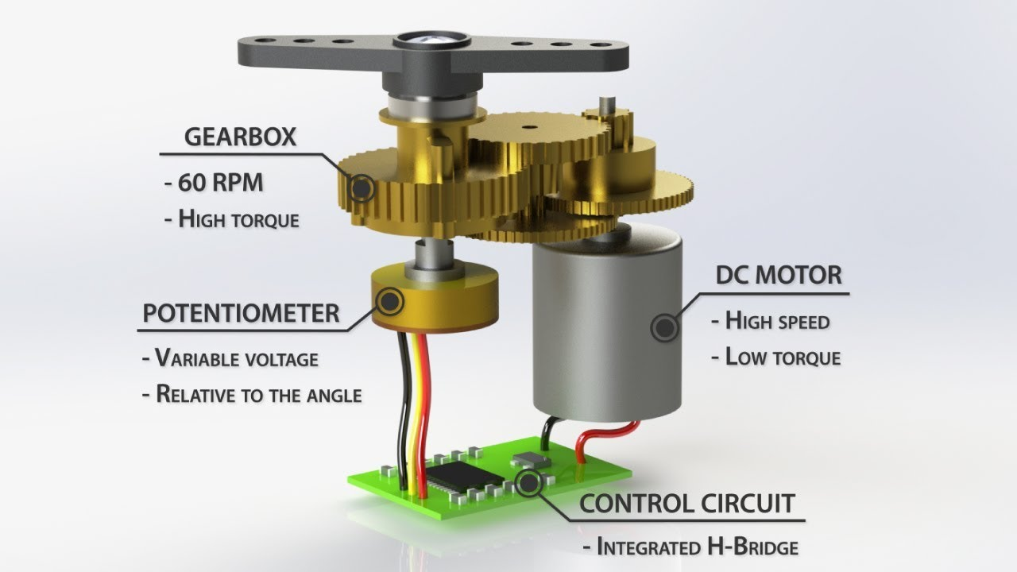
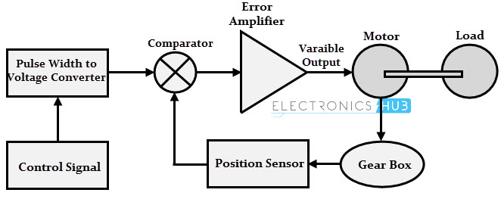
Servo motors works on Servomechanism that uses position feedback to control the speed and final position of the motor.
Servomechanism: is an automatic device that uses error-sensing negative feedback to correct the action of mechanism.
Or
Closed-loop mechanism to nullify the error between the designed and actual value automatically.
A Servo motor internally consists of
Motor (AC or DC)
Feedback Circuit
Controller and
Other Electronic circuit.

Slide 25
Brushless DC (BLDC) Motor

Slide 26
EVOLUTION
CONVENTIONAL DC MOTOR
PERMANENT MAGNET DC MOTOR (PMDC)
BRUSHLESS PERMANENT DC MOTOR (BLPMDC)

Slide 27
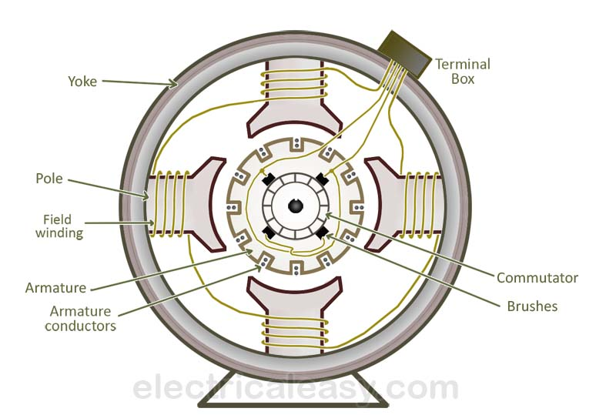
Conventional DC Motors
• Converts electrical energy to mechanical energy
• Principle- When a current carrying conductor placed in a magnetic field experiences a force
• Stator is made up of forced steel with inward projected poles and poles carry field windings and rotor is of silicon steel stampings

Slide 28
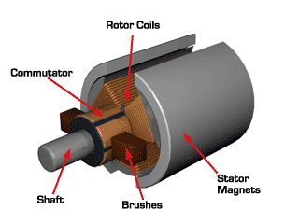
Permanent magnet DC motor
• Construction of PMDC is similar to conventional dc motor
• Stator poles are replaced by suitable permanent magnets
• No need to have field windings .

Slide 29
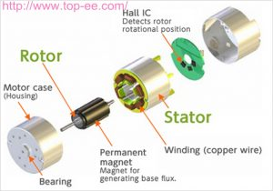
Brushless Permanent Magnet DC Motor
Brushless DC electric motor also known as electronically commutated motors (ECMs, EC motors) are synchronous motors that are powered by a DC electric source via an integrated inverter/switching power supply, which produces an AC electric signal to drive the motor .
– magnetic fields generated by the stator and rotor rotate at the same frequency
– no slip
The stator consists of several coils which current is led through Creating a magnetic field that makes the rotor turns .

Slide 30
Construction of BLDC
It consist of two parts mainly stator & rotor
Stator:
Stator is made up of silicon steel stampings with slots.
The slots are accommodated armature windings.
This winding is wound with specified no.of poles(even number).
This winding connected a dc supply through a power electronic switching circuits ( inverter circuits) .

Slide 31
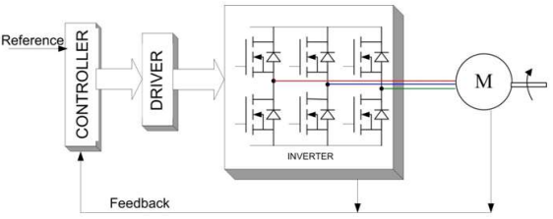
Rotor:
Rotor is of permanent magnet
no of poles on rotor is same as that of stator
Rotor shaft carries a RPS (Rotor position sensor) and it provides information about the position of shaft at any instant to the controller which sends signal to the electronic commutator .
The electronic commutator function is same as that of mechanical commutator in DC motor

Slide 32
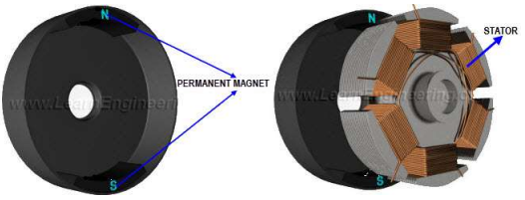
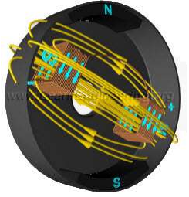
Working Of BLDC Motor
The rotor and stator of a BLDC motor are shown in the fig . It is clear that, the rotor of a BLDC motor is a permanent magnet.
The stator has a coil arrangement, as illustrated; The internal winding of the rotor is illustrated in the Fig(core of the rotor is hidden here). The rotor has 3 coils,named A, B and C.
Out of these 3 coils, only one coil is illustrated in the Fig for simplicity. By applying DC power to the coil, the coil will energize and become an electromagnet .

Slide 33
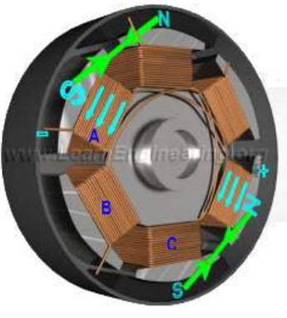
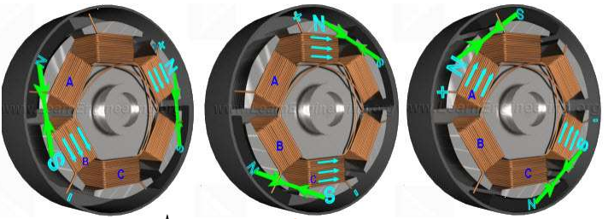
The operation of a BLDC is based on the simple force interaction between the permanent magnet and the electromagnet.
In this condition, when the coil A is energized, the opposite poles of the rotor and stator are attracted to each other (The attractive force is shown in green arrow).
As a result the rotor poles move near to the energized stator.
As the rotor nears coil A, coil B is energized. As the rotor nears coil B, coil C is energized. After that, coil A is energized with the opposite polarity . This process is repeated, and the rotor continues to rotate.
Fig: Coil energizing sequence, A, B, C, A

Slide 34
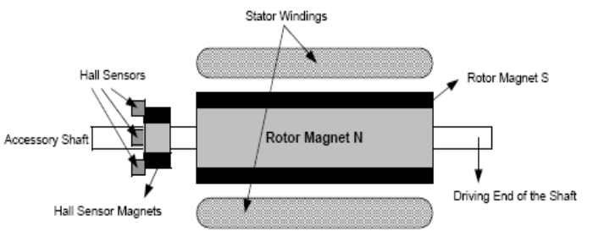
Unlike a brushed DC motor, the commutation of BLDC motor is controlled electronically.
It is important to know the rotor position in order to understand which winding will be energized following the energizing sequence.
Rotor position is sensed by different ways some of them are
1) Hall sensors 2) Optical encoders
Hall Sensors
When a magnetic field applied to a system with electric current a hall voltage Perpendicular to the field and to current is generated. This was discovered by Edwin Hall in 1879.

Slide 35
Advantages & Disadvantages
Advantages:
Increased Reliability & Efficiency
Longer Life
Elimination of Sparks from Commutator
Reduced Friction
Faster Rate of Voltage & Current
Disadvantages:
Requires Complex Drive Circuitry
Requires additional Sensors
Higher Cost
Some designs require manual labor (Hand wound Stator Coils)

Slide 36
Applications
Consumer: Hard Drives, CD/DVD Drives, PC Cooling Fans, toys, RC airplanes, air conditioners
Medical: Artificial heart, Microscopes, centrifuges, Arthroscopic surgical tools, Dental surgical tools and Organ transport pump system.
Vehicles: electronic power steering, personal electric vehicles
Airplanes: an electric self launching sailplane, flies with a 42kW DC/DC brushless motor and Li-Ion batteries and can climb up to 3000m with fully charged cells

